Slide 1

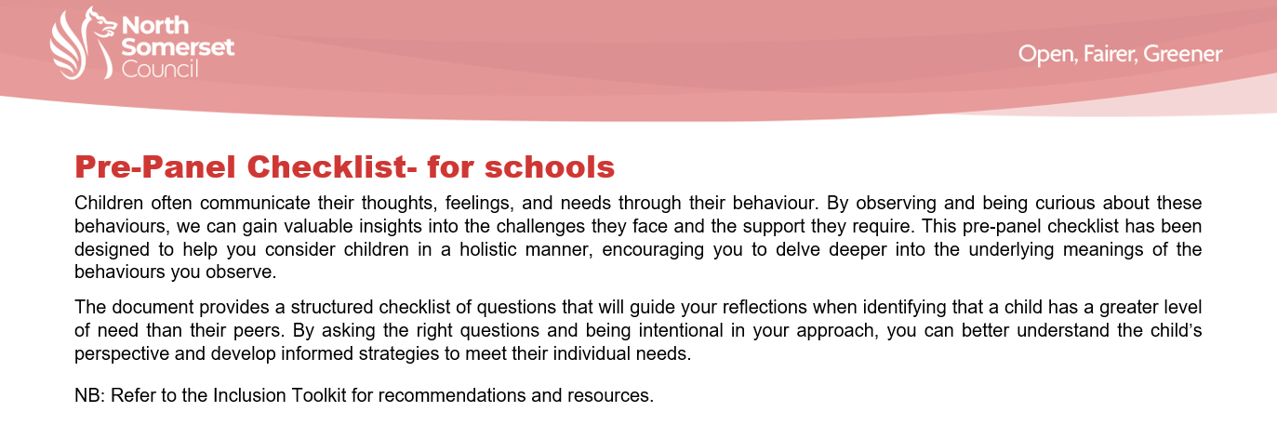
VLC Inclusion Toolkit, Pre-Panel Checklist and Outreach Update June 2026

Slide 2
Updates to the Inclusion Toolkit – Term 1 2025
A wide range of information, training and resources is available via the North Somerset Educational Psychology Service:
https://n-somerset.gov.uk/my-services/schools-learning/educational-psychology-service
Pathological Demand Avoidance – https://www.pdasociety.org.uk/
Music therapy and wellbeing support can be sourced via West of England Music and Arts:
https://wema.org.uk/
Brandon Rewilded Forest School
Please contact rachael.scrase@brandontrust.org for more information
Brown Rock, Tickenham – Nature based life skills programme
Contact details:
Adrian Brooks email: flourish@brownrock.co.uk
phone: 07780703982
Pony Farm Bus – To raise awareness about where our food comes from
https://theponyfarmbus.co.uk
New Youth Justice and Prevention Service Young Futures Prevention Panel - yosadmin@n-somerset.gov.uk

Slide 3
Healthy Schools Bulletins are circulated by Steve Davis and signpost additional services available - Steve.Davis@n-somerset.gov.uk
New SEND provisions:
Nurture Group space at Christ Church CE Primary School
Speech and Language Resource Base at the Whiteoak Academies of Hannah More Infants and Grove Juniors in Nailsea
Resource Base specialising in ASC with anxiety at Priory Community School Academy (PCSA)
Nurture Group space at Ashcombe Nursery
Updates to Inclusion Toolkit - Term 2 2025
North Somerset EP and EBSA support reminder:
The goal of the North Somerset EBSA Pathway is to give schools and colleges tools and record-keeping templates that they can use immediately. Children’s underlying needs relating to attendance are encouraged to be met in a logical, evidence-based order. It has received highly positive feedback from schools since being released in September 2024.
The package (linked below) includes one-page guidance, three training videos, templates for structuring a response to EBSA, and a shared drive of free tools for each step of what we call The EBSA Pathway:
Emotionally based school avoidance (EBSA) | North Somerset Council
We also have a North Somerset guidance on Working Memory on the NSC website, which includes video training and a broad range of top tips and free classroom resources:
Working memory in the classroom | North Somerset Council
Further topics at the Educational Psychology Service include top tips for school-to-school transitions, how to deliver literacy interventions, and learning support for autistic students. The link to the Training Library is here
MHST (Mental Health Support Team) – Can support with emerging mental health needs. Jenny Adams – j.adams33@nhs.net

Slide 4
OTR – otrnorthsomerset.org.uk – mental health support for 11-18 year olds
Place 2 Be – https://parentingsmart.place2be.org.uk/ - support for 4-11 year olds and some articles suitable for adolescents with animated videos. Can support in school, e.g. 1:1 counselling, or with staff training and can also support parents / carers (monthly newsletter).
Forest School / Outdoor Learning AP:
Goblin Combe – goblincombeadventures@gmail.com
Banwell Equestrian - info@banwellequestriancentre.com
Ravenswood – specialist provision for students aged 4-19 years (not SEMH)
Ravenswood can deliver high quality training to your school or MAT.
Our training sessions can be delivered as twilights or inset day sessions at your school. We offer bespoke training sessions for schools or other organisations who would like training around SEND - e.g. communication, behaviour support, ASD strategies etc. We are able to provide consultancy work to support with individual pupils or small groups of pupils and to help develop strategies to support within the classroom. If you would like further information around any of these please contact:
Katie Barnes, Deputy Head
email: kbarnes@ravenswoodonline.org.uk
Westhaven Special School also provide outreach support - https://www.westhavenschool.org.uk/outreach/

Slide 5
Updates to Inclusion Toolkit - Term 3 2026
Oops card resource – see additional handout (supports coping with unexpected changes / interruptions)
Comic strip conversations – A useful tool to be used as part of a restorative approach. Further information can be found at https://www.whittington.nhs.uk/default.asp?c=46126
Sensory profiling intervention – (attached) To complete with student. Pictures cut out and used to support a sorting discussion – young person can position picture within grid. E.g. busy environments – how do they feel in a busy supermarket / playground / classroom / dining hall – this could provide further information regarding why they experience various levels of comfort / discomfort in different settings, e.g. perhaps it is the noise or smell or risk of being touched that they dislike
Updated Zones of Regulation 4 Point Scale – (attached)
Kooth - an online mental health and wellbeing platform for young people 10-25. All accessed at www.kooth.com. Young people can speak with our team of professionals through live messaging/chat or make use of all of the self-help tools, information, guidance and peer support.
Qwell – see additional flyer
North Somerset Public Health Team have recently commissioned a free mental health wellbeing support package from Qwell. This is similar to Kooth but for parents/carers. The service offers free, safe and anonymous mental health and wellbeing support. Support includes a supportive online community, counsellor support, practical advice and information as well as access to a range of emotional wellbeing tools. Please share the attached poster with your parent/carer community and display a copy in prominent places within your school environment. We are hearing that some parents are struggling to support the mental wellbeing of their children because of their own mental health needs so Qwell may provide some crucial support.
Widgit software – To create visuals to support students, including those with EAL (can translate into more than 80 languages) https://widgitonline.com/en/home

Slide 6
Updates to Inclusion Toolkit – Term 4 2026
www.SCERTS.com and https://autismlevelup.com for further support to ensure inclusive practice for students with autism and neurodivergence
Updates to Inclusion Toolkit – Term 5 2026
www.betterhealthns.co.uk Right Service Right Time based on iThrive model
Reminder re mental health support available from:
www.Kooth.com – young people 10-year-old +
www.Qwell.io – parents and carers
24/7 website access. Text chat with counsellor / practitioner from 12-10pm on weekdays and 6-10pm on weekends. Free and anonymous service. Four support pathways aligned with iThrive.
Sirona SilverCloud Digital Mental Health support for children and young people
https://sirona-cic.org.uk/blog/2025/12/02/introducing-silvercloud-digital-mental-health-support-for-children-and-young-people/
https://www.neurodiversetraining.org/
https://bnssghealthiertogether.org.uk/
https://www.place2be.org.uk/
Updates to Inclusion Toolkit - Term 6 2026
https://safehandsthinkingminds.co.uk/ - Dr Karen Treisman – Trauma Informed Practice information and resources

Slide 7
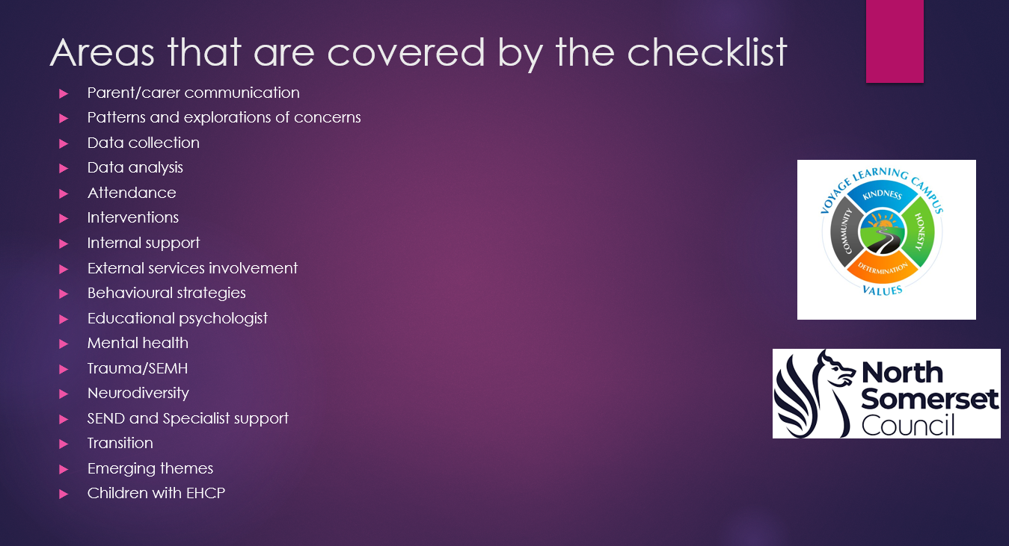

Slide 8
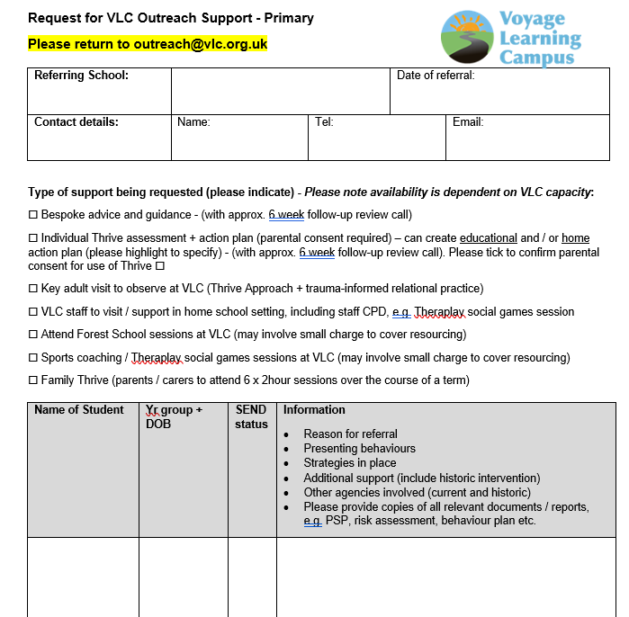
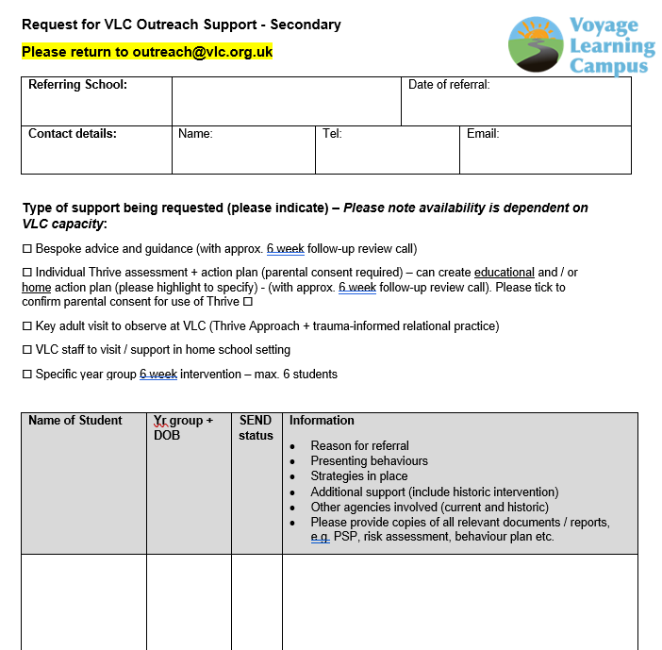
VLC outreach

Slide 9
VLC outreach 2025-2026
37 schools, 68 students (9 secondary + Phase 2 and 3 Thrive assessments and action plans). Pre-Panel Checklist. Plus 26 students supported through secondary outreach.
Start T6 = Primary Inclusion Panel 93 students from 37 schools
Start T6 = Secondary Inclusion Panel 104 students from 10 schools + 2 CME
Thrive (include ongoing 6 weekly reviews) = 42 children (3 secondary)
Intervention blocks at VLC - 11 blocks, 11 children – 9 different schools
Forest school - 4 bespoke blocks (+ included in intervention blocks)
Sports - 4 bespoke blocks + 4 included in intervention blocks
VLC visits to 8 different Primary schools + additional outreach provided to students other than VLC transitioning students at two schools when VLC staff supporting within new school + VLC outreach block students supported at VLC then within school x 2
26 students supported through Secondary outreach in main schools

Slide 10

VLC outreach next steps
Updated referral forms being launched September 2026 with new outreach email address
Observation proforma for use by VLC staff observing in schools and school staff observing at VLC

