Slide 1


Slide 2
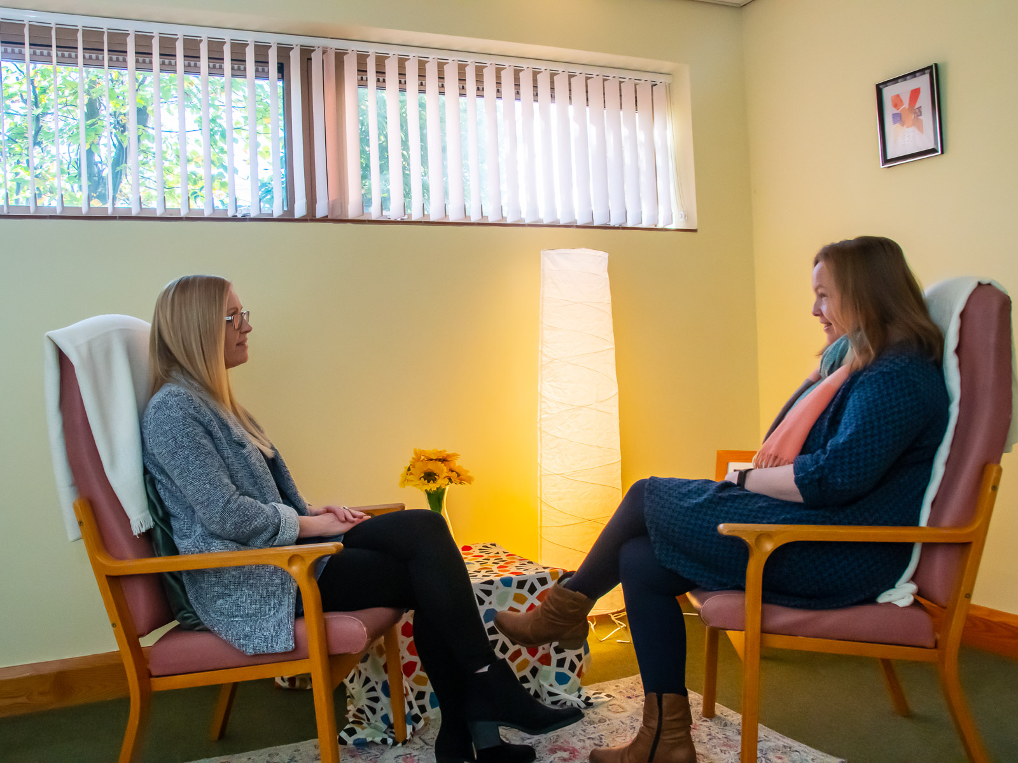
Numbers
In 2025 we carried out 2508 one to one counselling sessions with 11-18 year olds
We helped 209 11-18 years olds
We currently carry out around 95 sessions per week, a third of these with under 18s

Slide 3

Referral process
Clients are signposted via GPs, schools, CAMHS, other organisations or find out about us by word of mouth, social media etc.
11-18 year old clients’ parents usually contact us first by phone or email. Client contacts us directly by email or phone and let us know if they want a counsellor or a listener
Client/parent receives initial contact form
Assessment booked with client on phone with a counsellor, or a triage for the listening service
Client is put onto waiting list (time dependent on flexibility in their availability) or is referred onto listening service
Client is offered sessions with a counsellor who matches as closely as possible or if suitable is allocated to a listening mentor

Slide 4

Listener Pathway
Many YP who are referred to Wellspring do not need counselling but need someone they can trust to offload on to help them regulate their emotions and find out who they are
Our listeners are level 3 counselling students who are eager to gain work experience using their listening skills. They are supervised by our YP safeguarding lead
The meetings take place in local cafes in Nailsea, Portishead, Clevedon and WSM
The service is faster than waiting for counselling so YP the help when they need it (at point of referral, not point of availability)

Slide 5


Slide 6
Client journey
Client is assessed usually on phone
Client is triaged on the phone for the listening service
Client waits up to 6 months for counselling to start
Client is referred to listening service and is seen within a month

Slide 7
Client journey
Any risk or safeguarding concerns are passed to parent, school safeguarding team, Social Care or GP as appropriate
Clients have 12 counselling sessions of 50 minutes, this can be extended for 6 or more sessions (costs £15 per session)
Clients have 5 listening sessions of 35 minutes each, this can be extended x 5
(free)

Slide 8
Problems we work with:
Low Mood/depression
Anxiety/panic
School avoidance
Low self-esteem
Relationship problems
Childhood events
Past trauma
Bereavement
Stress
Self-harm and suicidal ideation

Slide 9
What we don’t do
Work with families/parents/couples
Work with young people who are actively suicidal
Work with people who are addicted or under the influence of drugs/alcohol
Hold risk confidential
Work with couples
Work with people with acute mental health problems
Work with young people who have been forced to attend counselling
Work with under 11 year olds
Open ended counselling
Act as an emergency service

Slide 10
Typical presentations for Listening Service
Anxious or stressed about school, exams, friendships
Neurodivergent individuals who are anxious about school
Struggling with family breakdown
Needing an adult to talk to/offload on
Mild self-harming behaviours

Slide 11
What we do in Counselling sessions
Offer humanistic counselling based on psychological theory
Build relationships
Exploration of ‘self’ and emotions
Some counsellors use creative approaches
Give clients autonomy
Share info with parents only if the client thinks it would be helpful or if there is a safeguarding concern

Slide 12
Contact Details
For self-referrals:
reception@wellspringcounselling.org.uk
01275 810879
For info:
https://wellspringcounselling.org.uk
Find us on Facebook and Instagram

