Slide 1


Pre panel Checklist: improving our inclusion practice and ensuring consistency across the county
Feb 2026

Slide 2

EEF: Building a culture of community and belonging
Be inclusive by design, promoting positive relationships and attitudes
Promote positive relationships and active engagement for all students
Adopt a positive and proactive approach to behaviour for learning
Notes:
1. Be inclusive by design, promoting positive relationships and attitudes
Creating a positive and supportive environment for all pupils means reinforcing a shared language, activity, routines and strategies throughout the school. Effective teaching and learning requires positive relationships and interactions between teachers and pupils
2. Promote positive relationships and active engagement for all pupils
Effective teaching and learning requires positive relationships and interactions between teachers and pupils. Research has suggested that teachers’ attitudes towards the inclusion of pupils with SEND are reflected in the quality of their interactions with pupils. A systematic review exploring approaches to effectively including children with SEND in mainstream classrooms found that teachers with positive attitudes towards the inclusion of children with SEND had better quality interactions with pupils. These teachers saw themselves as responsible for the learning of all pupils and had longer interactions with pupils with SEND, using this time to ensure they fully participated in the class.
An inclusive school environment for pupils with SEND is also beneficial for all pupils. One recent meta-analysis explored the impact of inclusion on pupils without SEND and concluded that such an inclusion policy resulted in a weak but positive impact on their academic outcomes.
3. Adopt a positive and proactive approach to behaviour for learning
Where behaviour is good in schools, it is easier for pupils to forge strong positive relationships both with their peers and with staff, which can create a more inclusive environment in which pupils feel seen, understood and safe. This is important not only for a positive and enjoyable school culture, but it is also likely to support attendance where absences or internal truancy may be caused by pupils not feeling they fully ‘belong’ in the school.
There is strong evidence that a proactive, positive and supportive approach to behaviour will benefit all pupils and can reduce the challenging behaviours. This includes:
Encouraging and rewarding positive behaviour.
Explicitly prompting, modelling and reinforcing positive behaviours.
Understanding reasons behind pupil behaviour and addressing these where possible.
The general climate for learning can be improved through the explicit teaching of learning behaviours alongside managing misbehaviour. Several high-quality studies suggest the benefit of teaching learning behaviours and self-regulation. For more information, see Improving Behaviour in Schools, and the Metacognition and Self-Regulation guidance report.

Slide 3
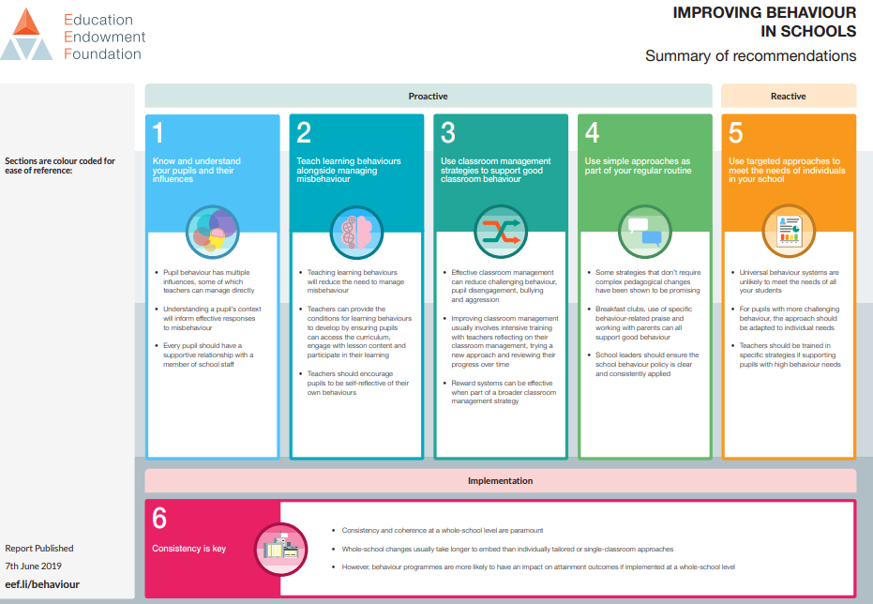

Slide 4
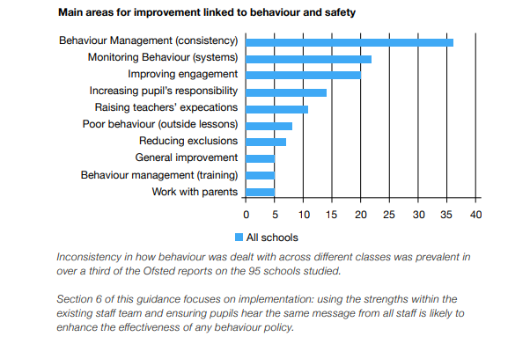

Beacon School: 7 Reasons why good behaviour policies fail in good schools

Slide 5
Main Reasons & Their Percentages for permanent Exclusions in the UK 2024-25?
1. Persistent disruptive behaviour — 38 %
This was the most commonly recorded reason for permanent exclusions, reflecting ongoing behavioural challenges such as repeated disruption of learning or persistent violation of school rules.
2. Physical assault against a pupil — 16 %
This category covers incidents where excluded pupils physically assaulted another student.
3. Physical assault against an adult — 13 %
This reason includes situations where a pupil physically assaulted an adult (e.g., teacher or support staff).

Slide 6
How does this relate to current practice in North Somerset 2025-26?
Until 19/01/26 ,there have currently been 16 PEXs in North Somerset all in secondary. 2 PEXs were rescinded.
Persistent Disruptive behaviour – 8 students =50%
Physical assault (against students or member of staff- 5 students= 31%
Verbal Assault- 2 students 13%
Drug related incidents- 1 student- 6%

Slide 7
Pre Inclusion panel Checklist
Rationale:
Children and young people often communicate their thoughts, feelings, and unmet needs through their behaviour. By observing these behaviours with curiosity and professional reflection, practitioners can gain valuable insight into the difficulties a child may be experiencing and the support required to promote positive outcomes.
This pre-panel checklist has been designed to support a holistic, child-centred approach within the Early Help process. It encourages practitioners to look beyond presenting behaviours and consider the wider context of the child’s life, including emotional wellbeing, family circumstances, and environmental factors that may be impacting their development.
The checklist provides a structured set of reflective questions to guide practitioners when identifying that a child’s needs may be greater than those of their peers. By promoting thoughtful analysis and shared understanding, it supports informed decision-making at panel, helping to ensure that the right level of support is identified and that interventions are proportionate, timely, and responsive to the child and family’s needs.

Slide 8
Areas that are covered by the checklist
Parent/carer communication
Patterns and explorations of concerns
Data collection
Data analysis
Attendance
Interventions
Internal support
external services involvement
Behavioural strategies
Educational psychologist
Mental health
Trauma/SEMH
Neurodiversity
SEND and Specialist support
Transition
Emerging themes
Children with EHCP

Slide 9
The process...
Raise the case at the Inclusion Panel by fully completing the referral form. Indicate what interventions and support have already been put in place for the child, including timescales and impact.
Refer to VLC (or other relevant services) as appropriate.
Send any necessary referrals and ensure the Inclusion Team is aware of additional support / interventions being implemented.

